Slide 2
YOUR NAME
Please specify your name below
Arevik Arakelyan

Slide 3
ANDROID

Slide 4
#1`
ANDROID STUDIO

Slide 5
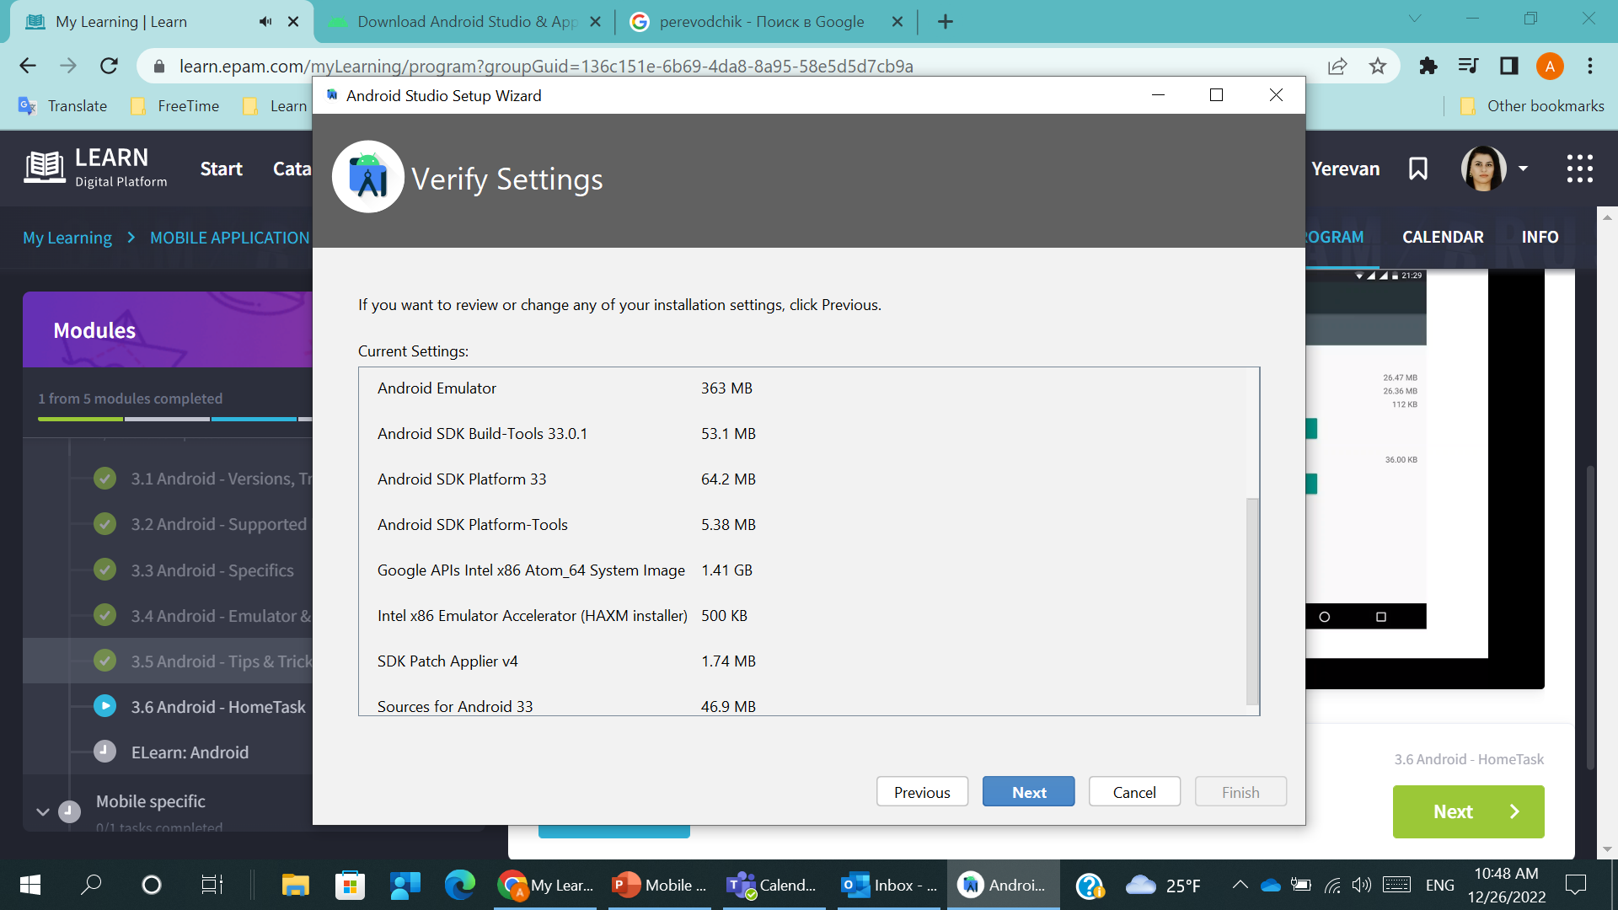
ANDROID #1.1
Download Android Studio (please find links on the notes to the slide).
Note that it take some time
Notes:
Android Studio - https://developer.android.com/studio/index.html
Java (command line tools require it) - http://www.oracle.com/technetwork/java/javase/downloads/jdk8-downloads-2133151.html

Slide 6
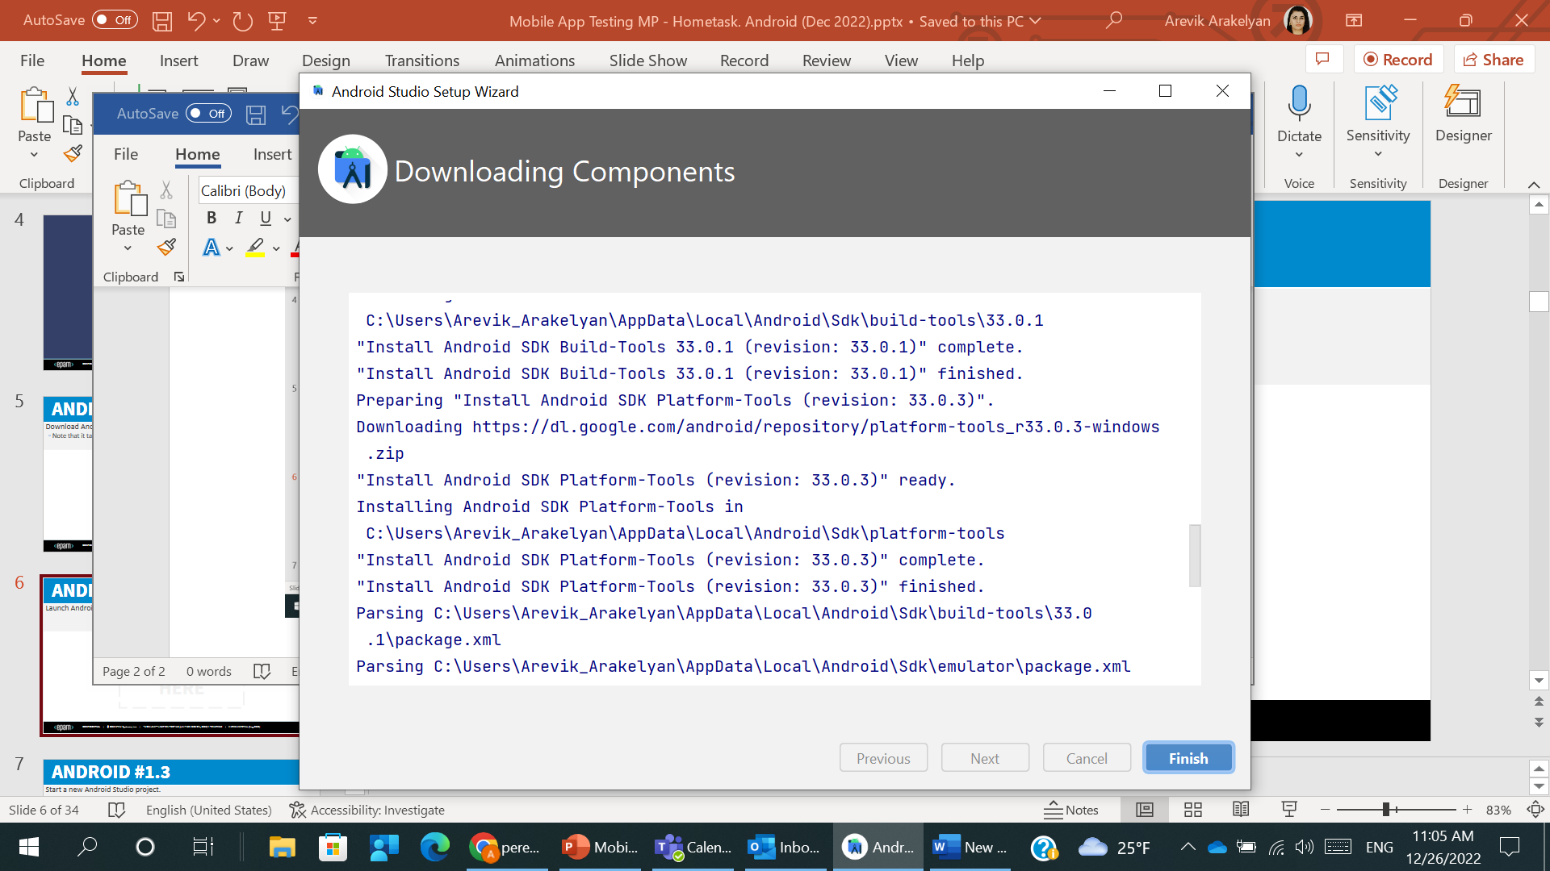
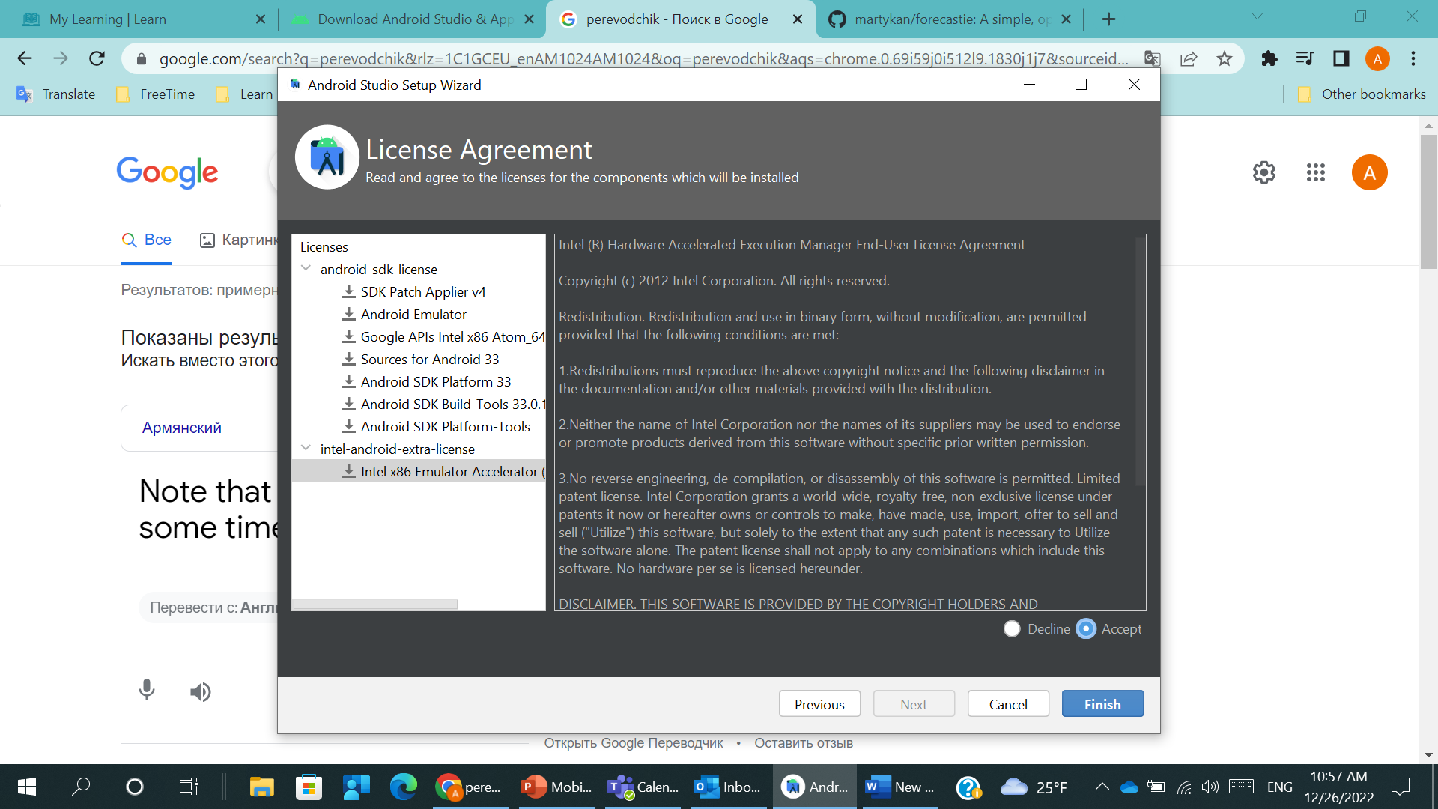
ANDROID #1.2
Launch Android Studio Settings => SDK Manager

Slide 7
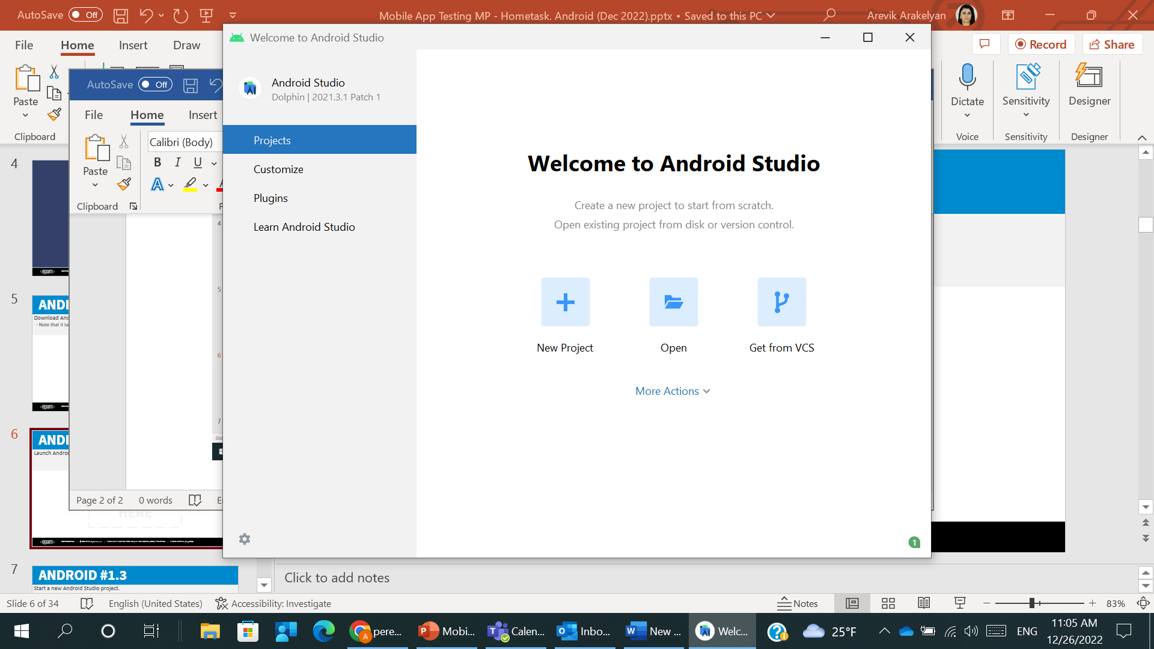
ANDROID #1.3
Start a new Android Studio project.
Provide just a final screenshot from Android Studio.

Slide 8
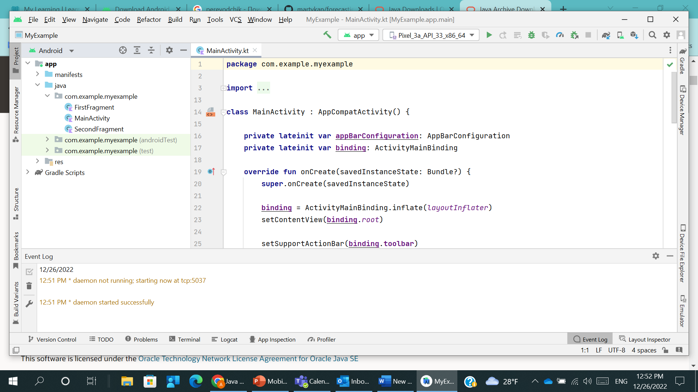
ANDROID #1.4
Place where device Logs is/will be displayed (for the app)

Slide 9
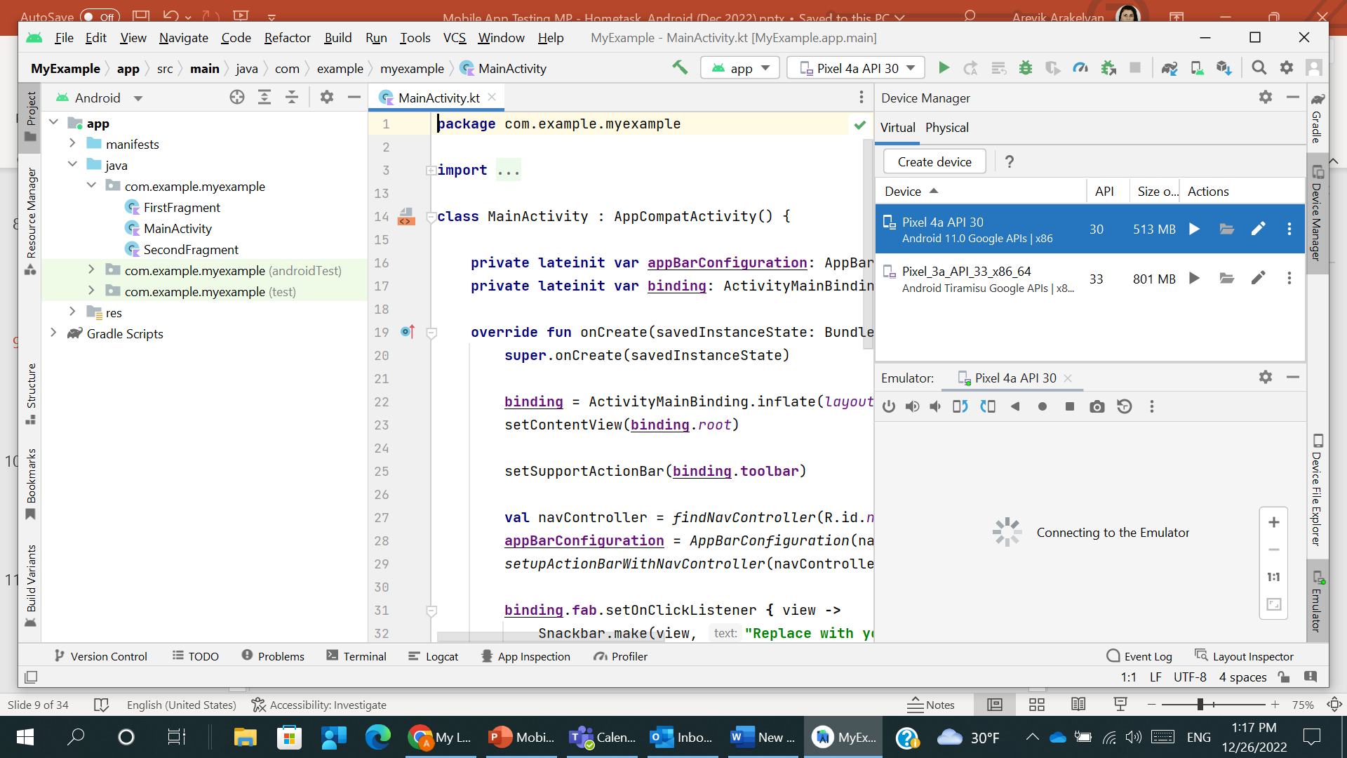
ANDROID #1.5
Launch AVD Manager.
Create new Virtual Device with one of the latest Android versions

Slide 10
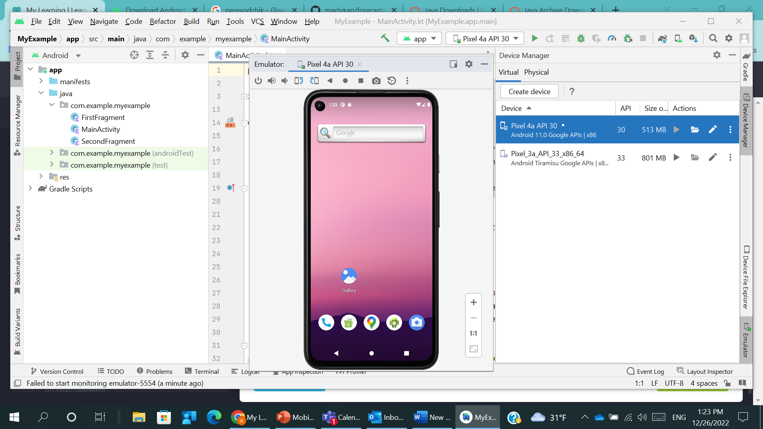
ANDROID #1.6
Launch just created Virtual Device

Slide 11
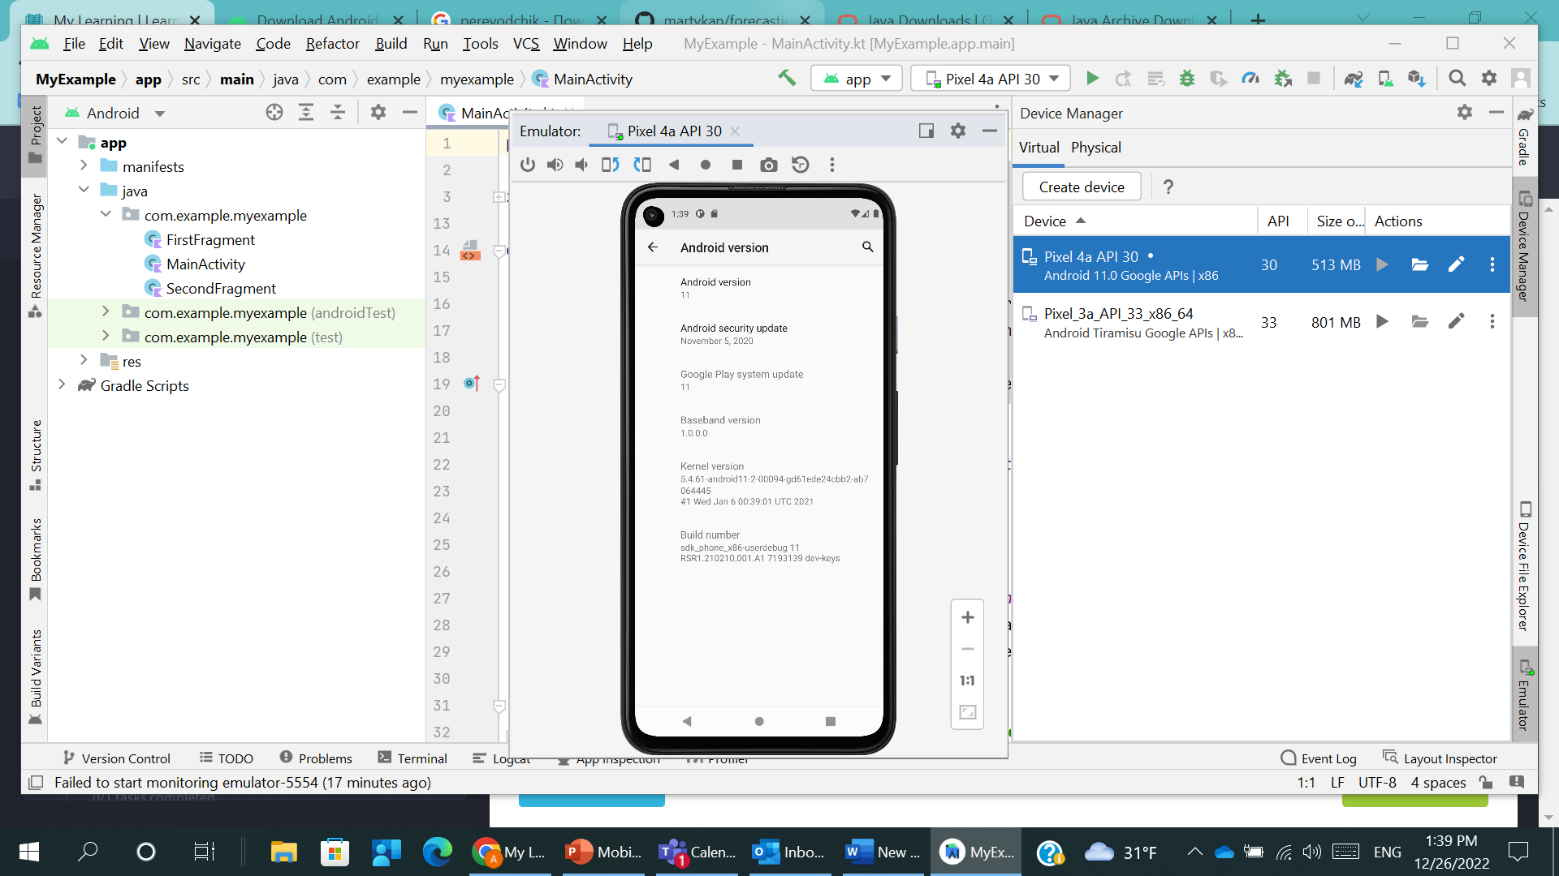
ANDROID #1.7
Go to Android emulator Settings & show its OS version

Slide 12
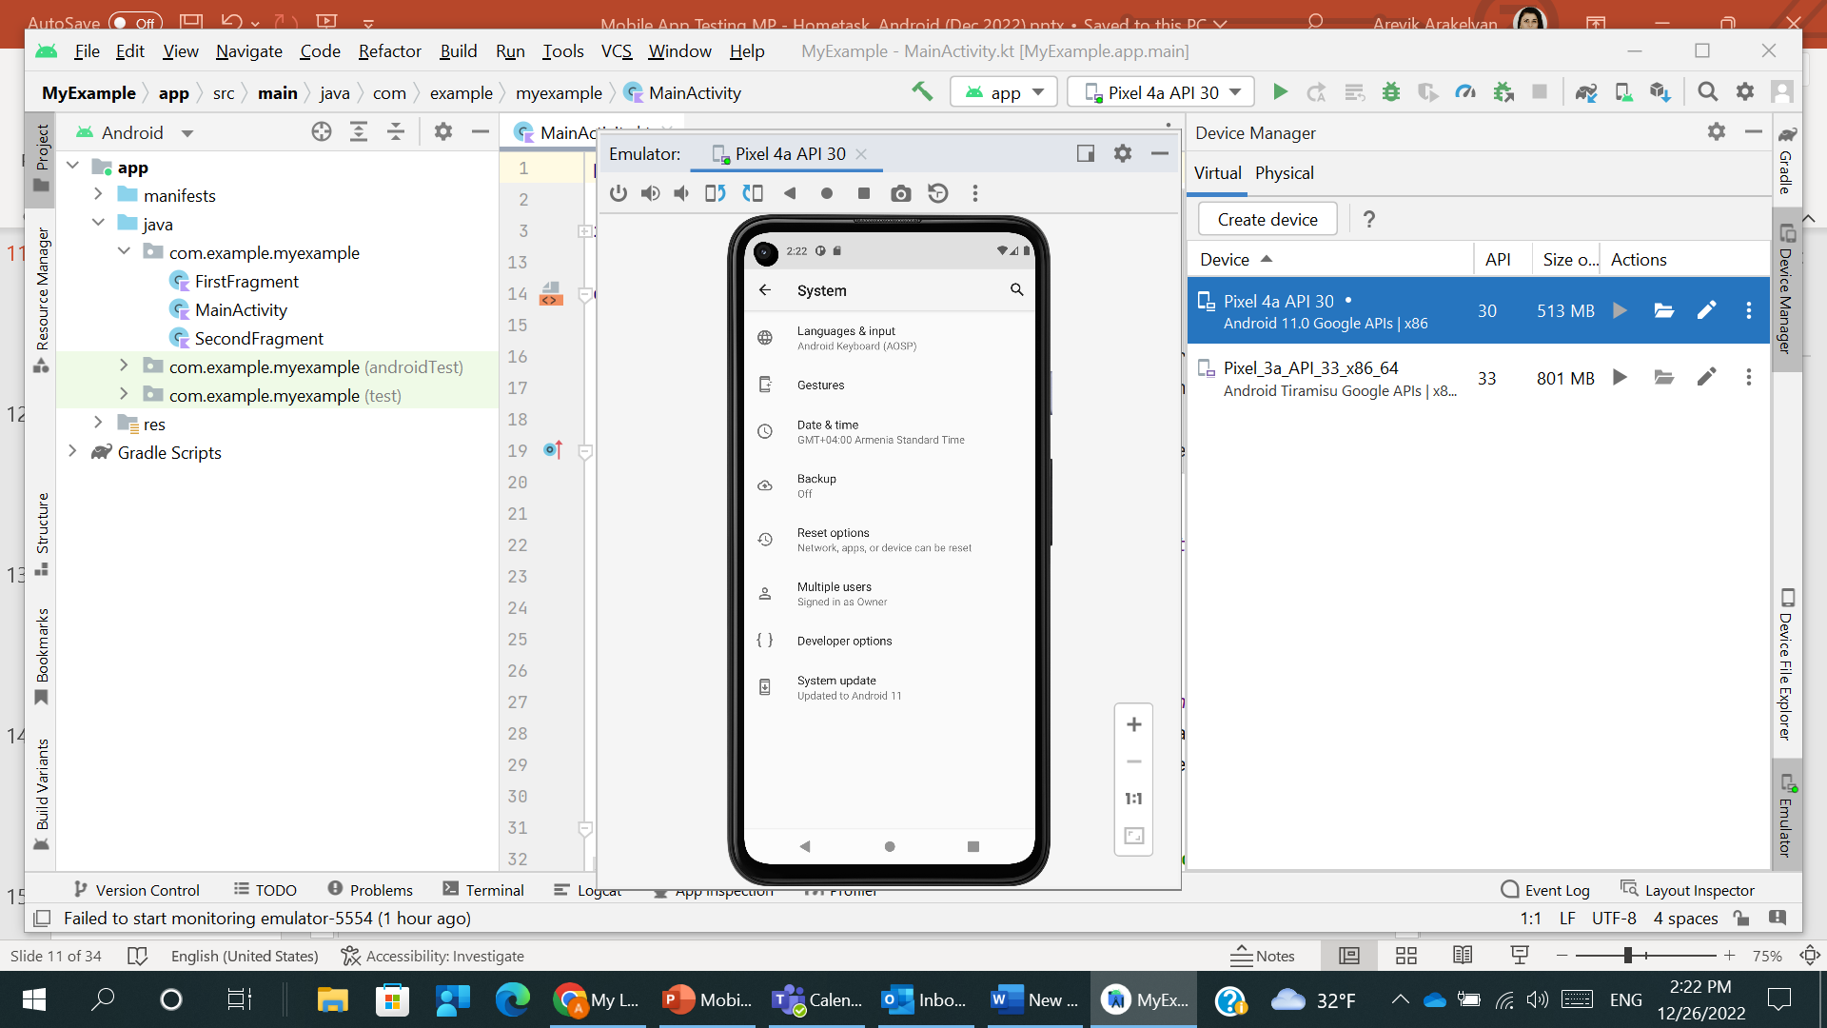
ANDROID #1.8
Activate Developer Options

Slide 13
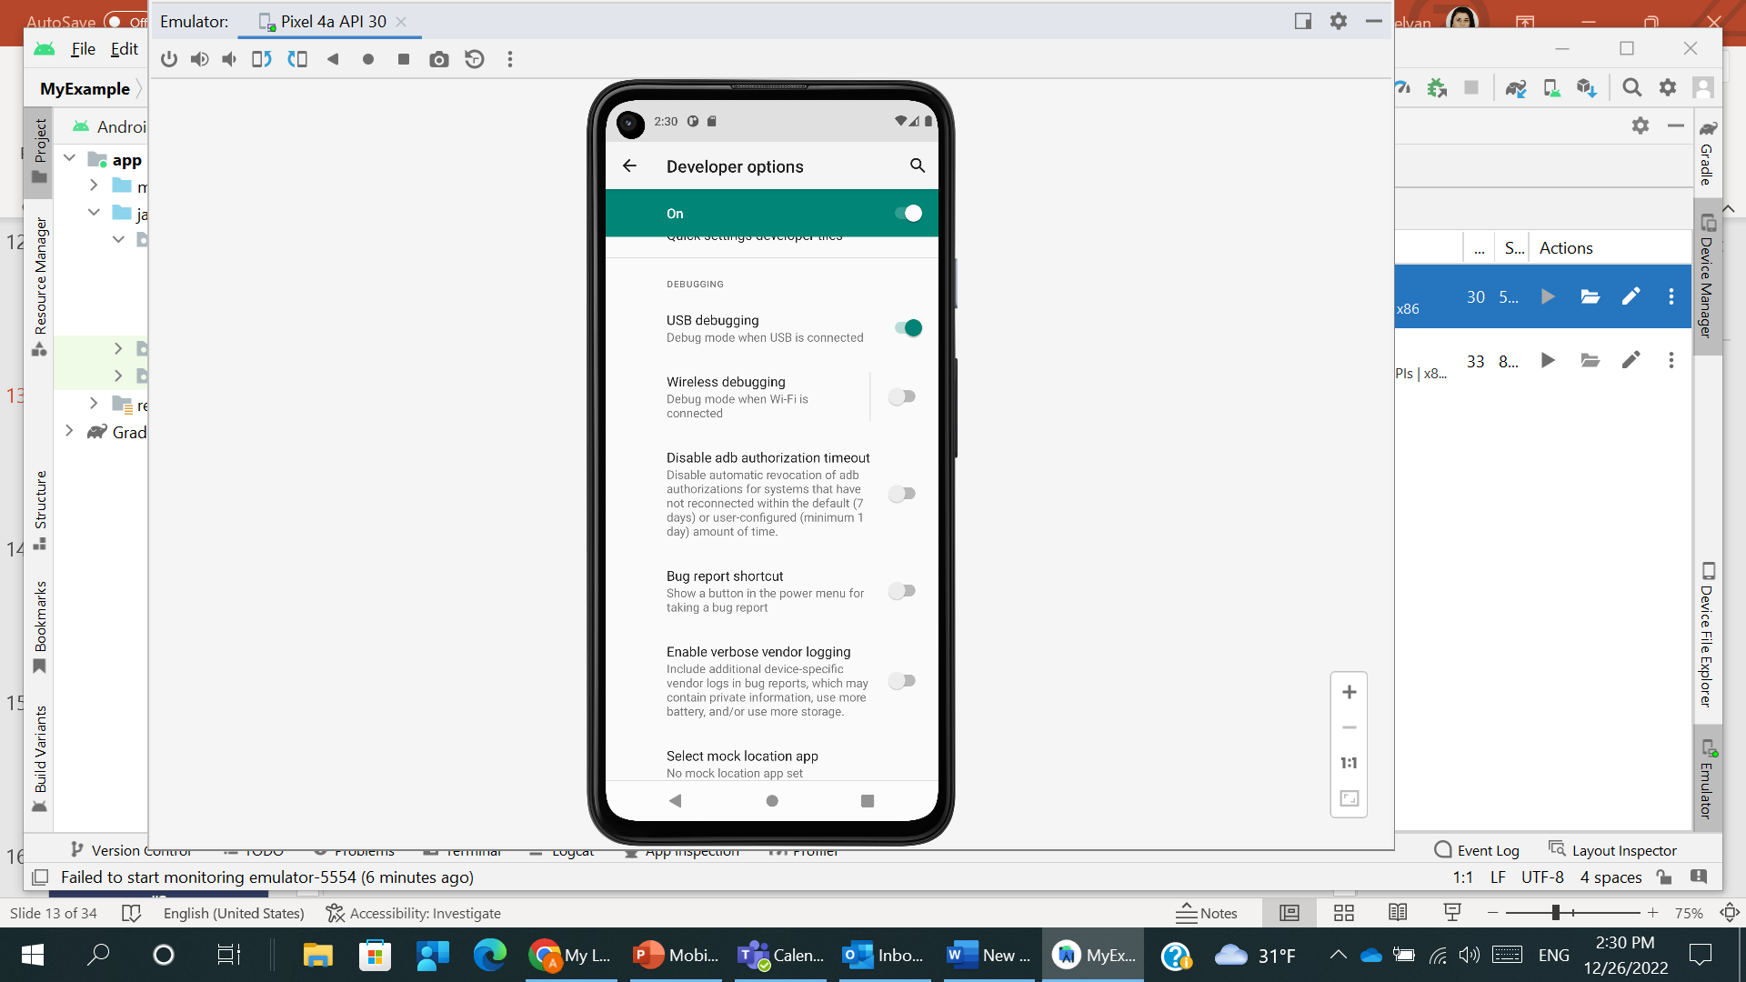
ANDROID #1.9
Enable USB Debugging

Slide 14
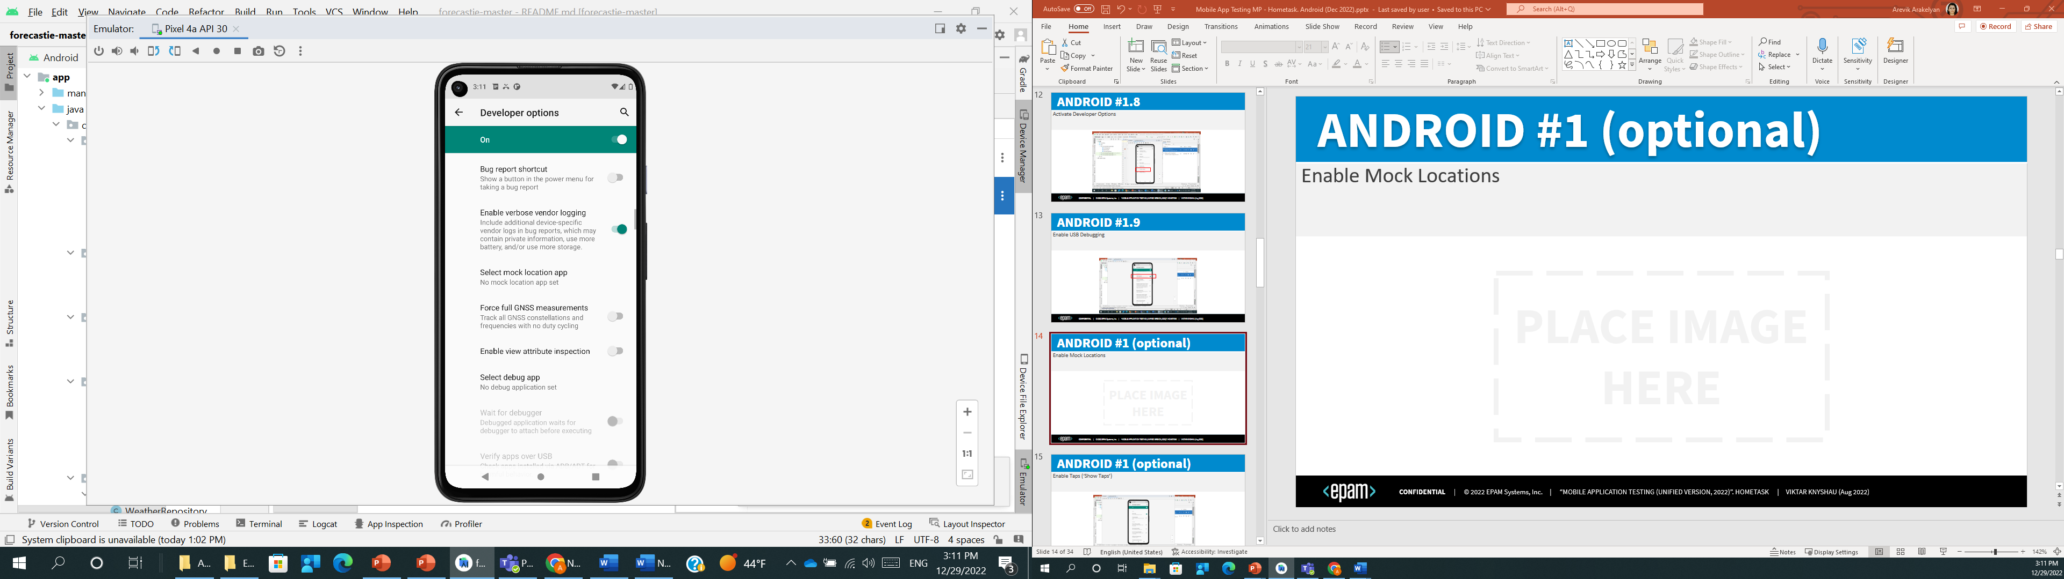
ANDROID #1 (optional)
Enable Mock Locations
Notes:
For this section we need to download fake GPS

Slide 15
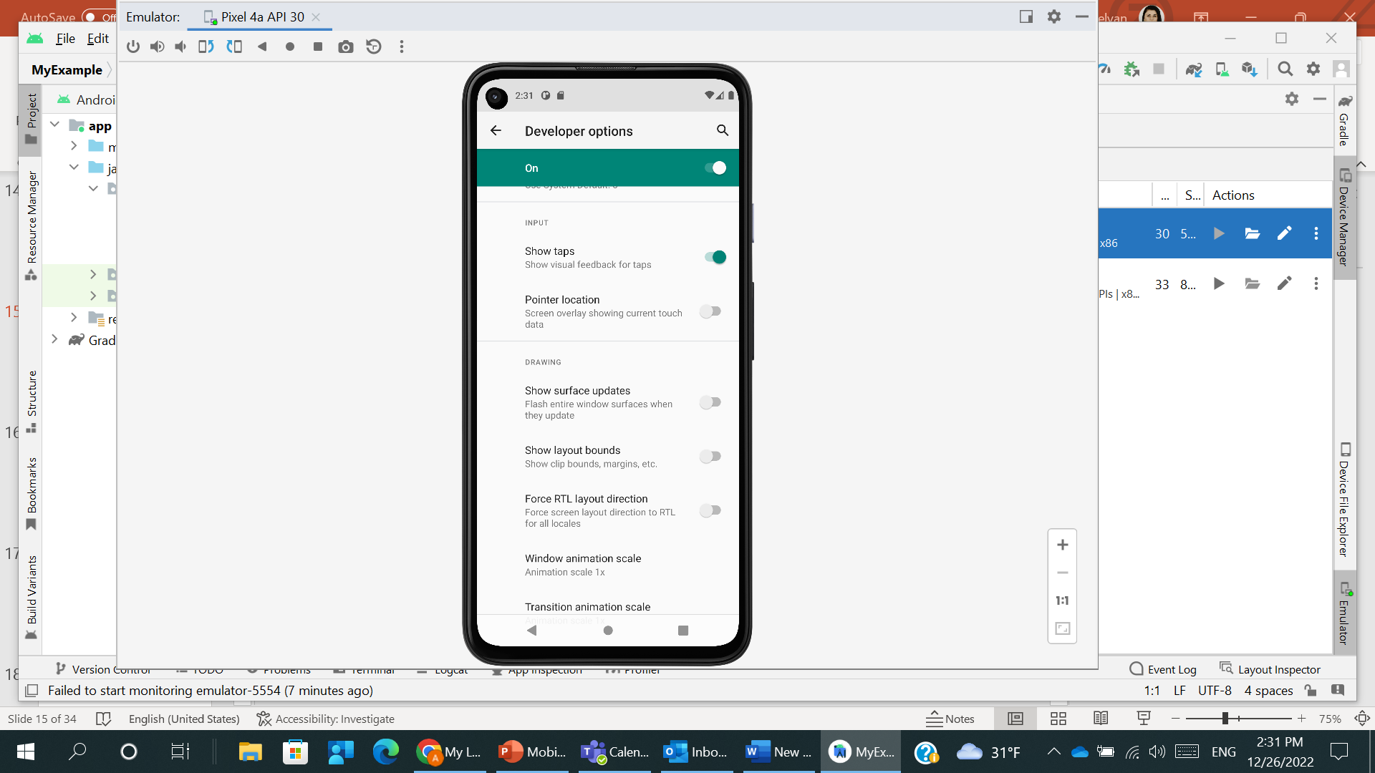
ANDROID #1 (optional)
Enable Taps (‘Show Taps’)

Slide 16
#2
ANDROID EMULATOR

Slide 17
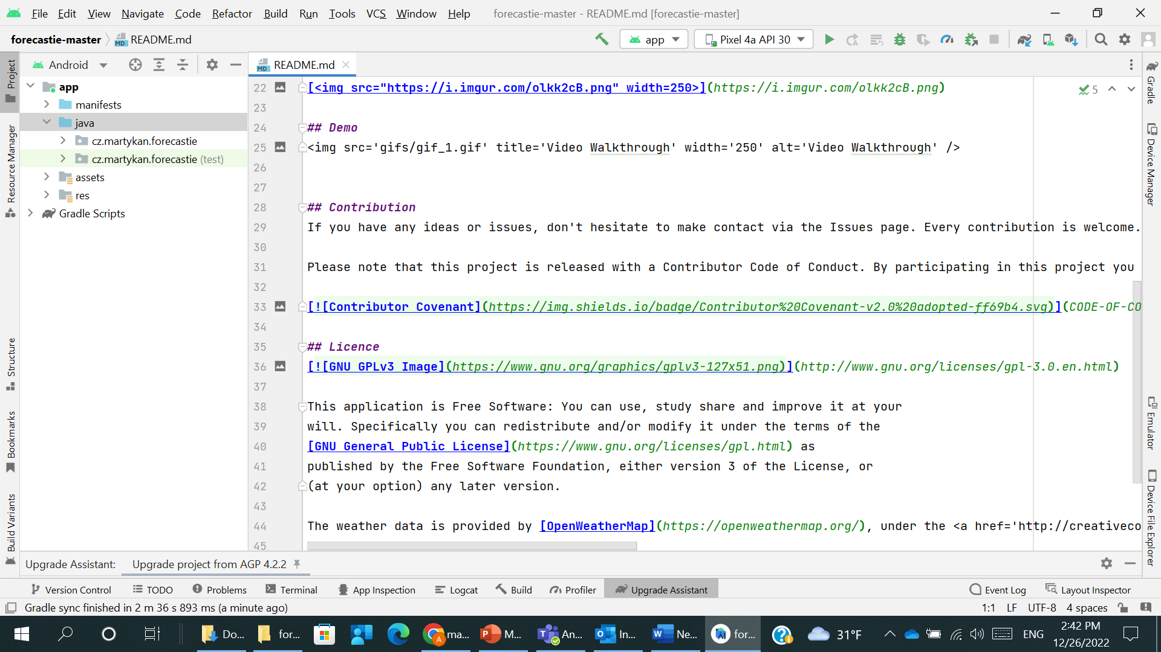
ANDROID #2.1
Download the project using the link from notes.
Extract files from ZIP archive. Open it in Android Studio.
Notes:
https://github.com/martykan/forecastie

Slide 18
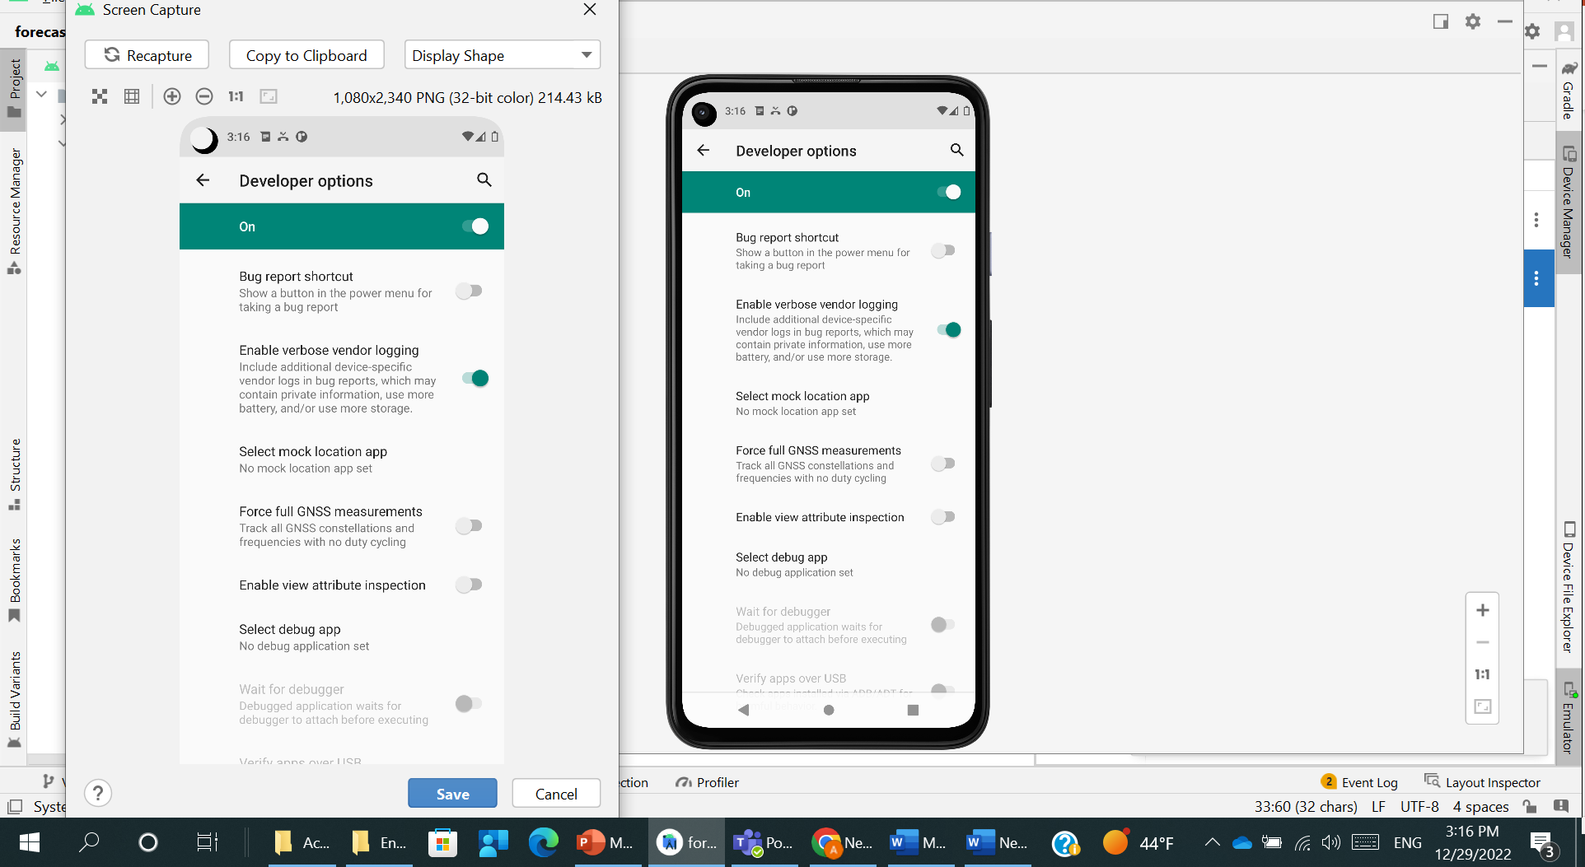
ANDROID #2.2
Run Project on Virtual Device. Make an emulator screenshot

Slide 19
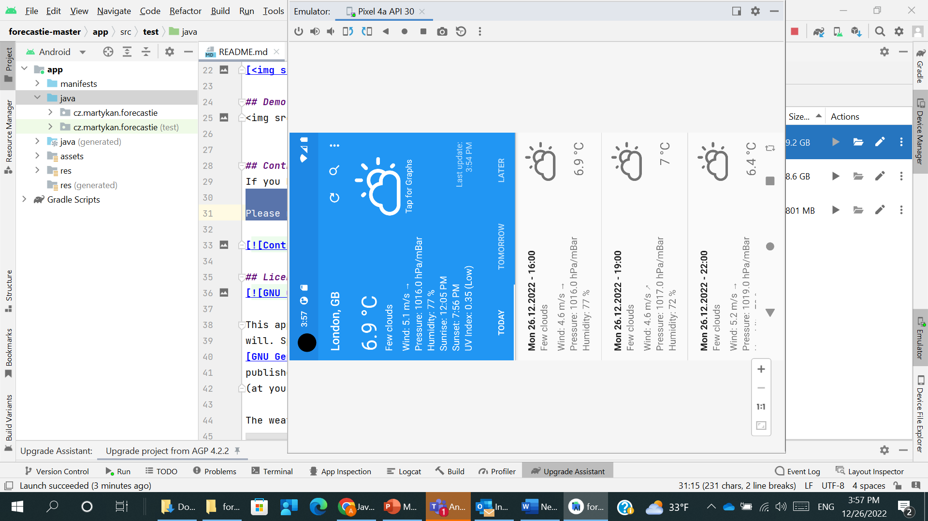
ANDROID #2.3
Rotate Device

Slide 20
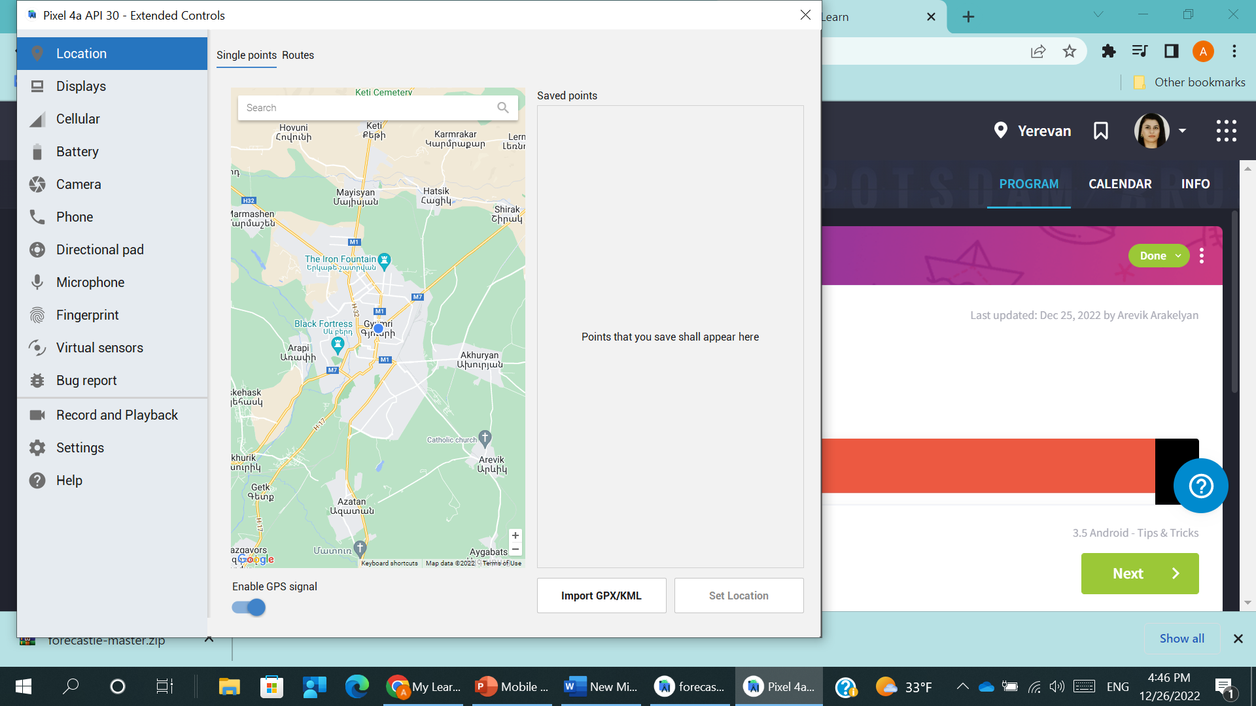
ANDROID #2.5
Working with Emulator: Set Location (show the place where to set)
Latitude: 53.46
Longitude: -2.29. / or You can open Google Maps & show current location /

Slide 21
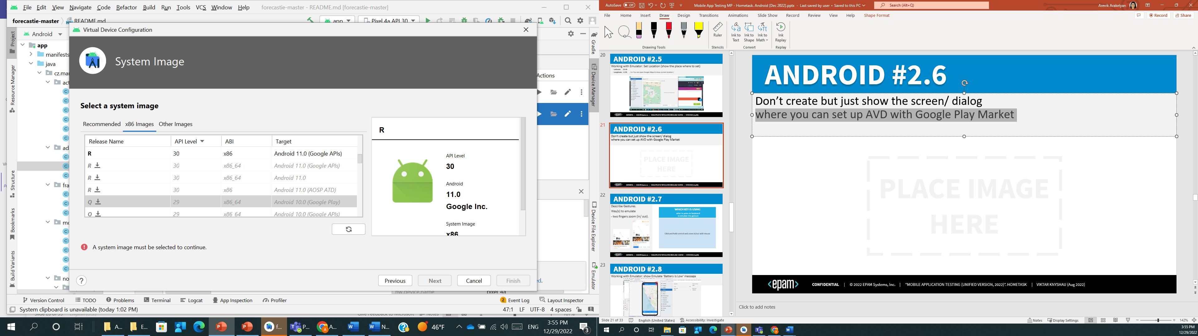
ANDROID #2.6
Don’t create but just show the screen/ dialog
where you can set up AVD with Google Play Market

Slide 22
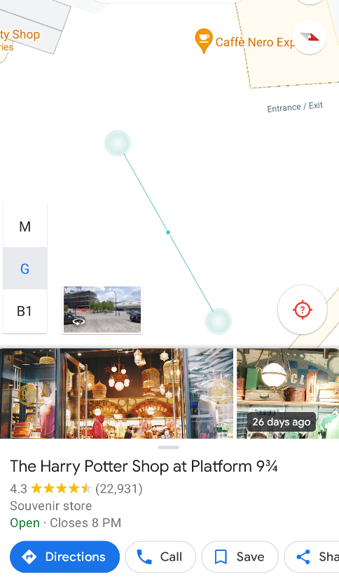
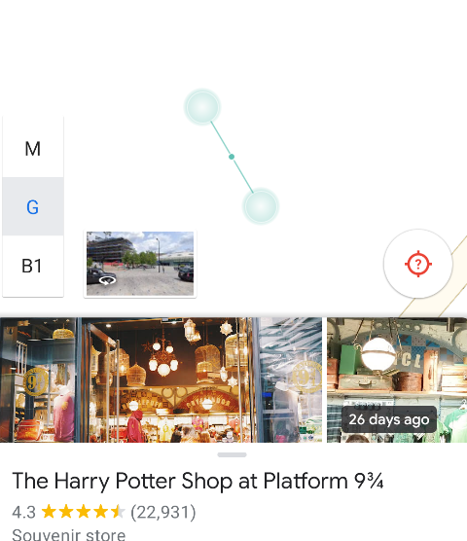
ANDROID #2.7
Describe Gestures.
Way(s) to emulate
- two fingers zoom (in/ out).
WHICH KEY IS USING what to press on keyboard to emulate this gesture
Click and hold control and zoom in/out with mouse

Slide 23
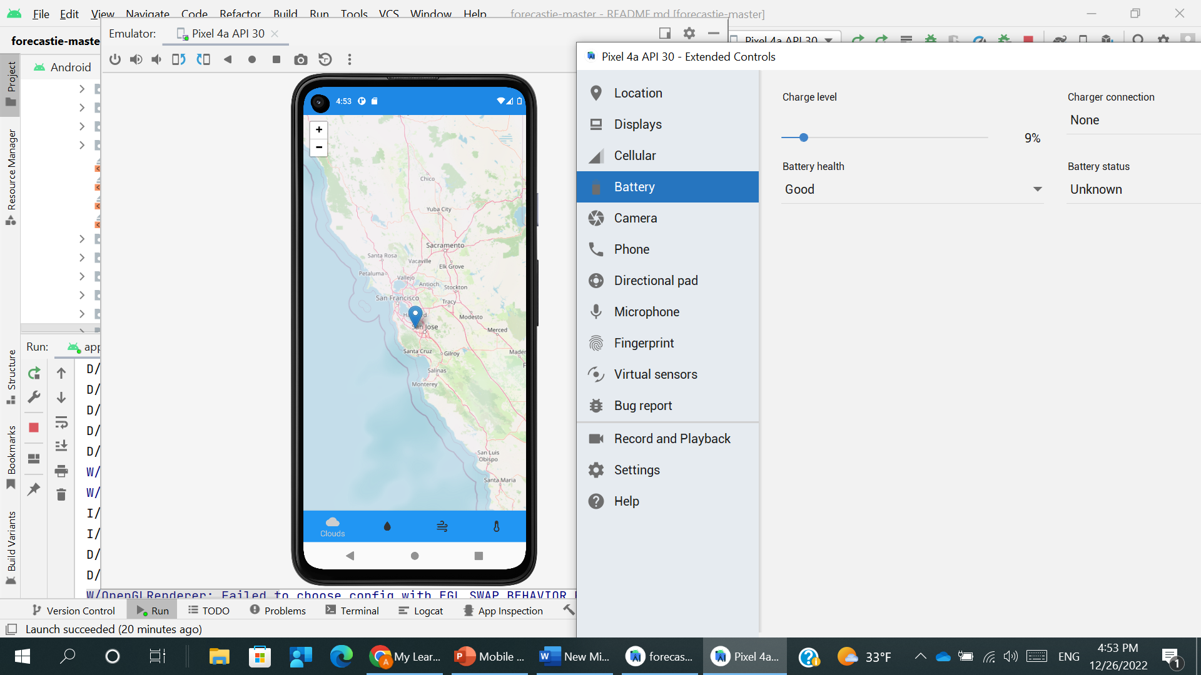
ANDROID #2.8
Working with Emulator: show Emulate ‘Battery is Low’ message

Slide 24
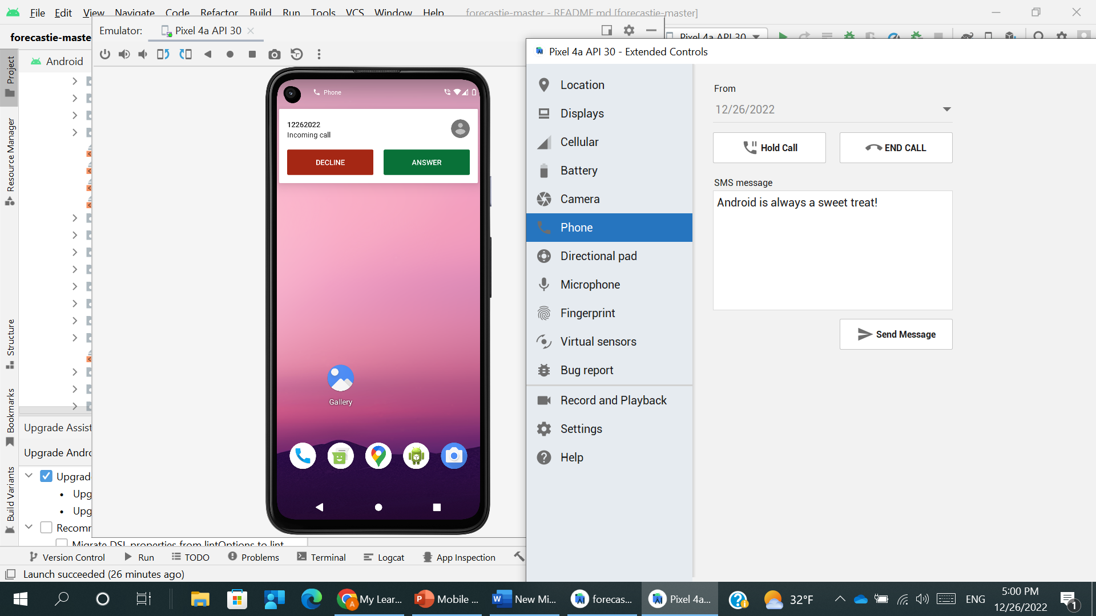

ANDROID #2.9
Working with Emulator: Emulate Incoming Call
Number should be equal to current date

Slide 25
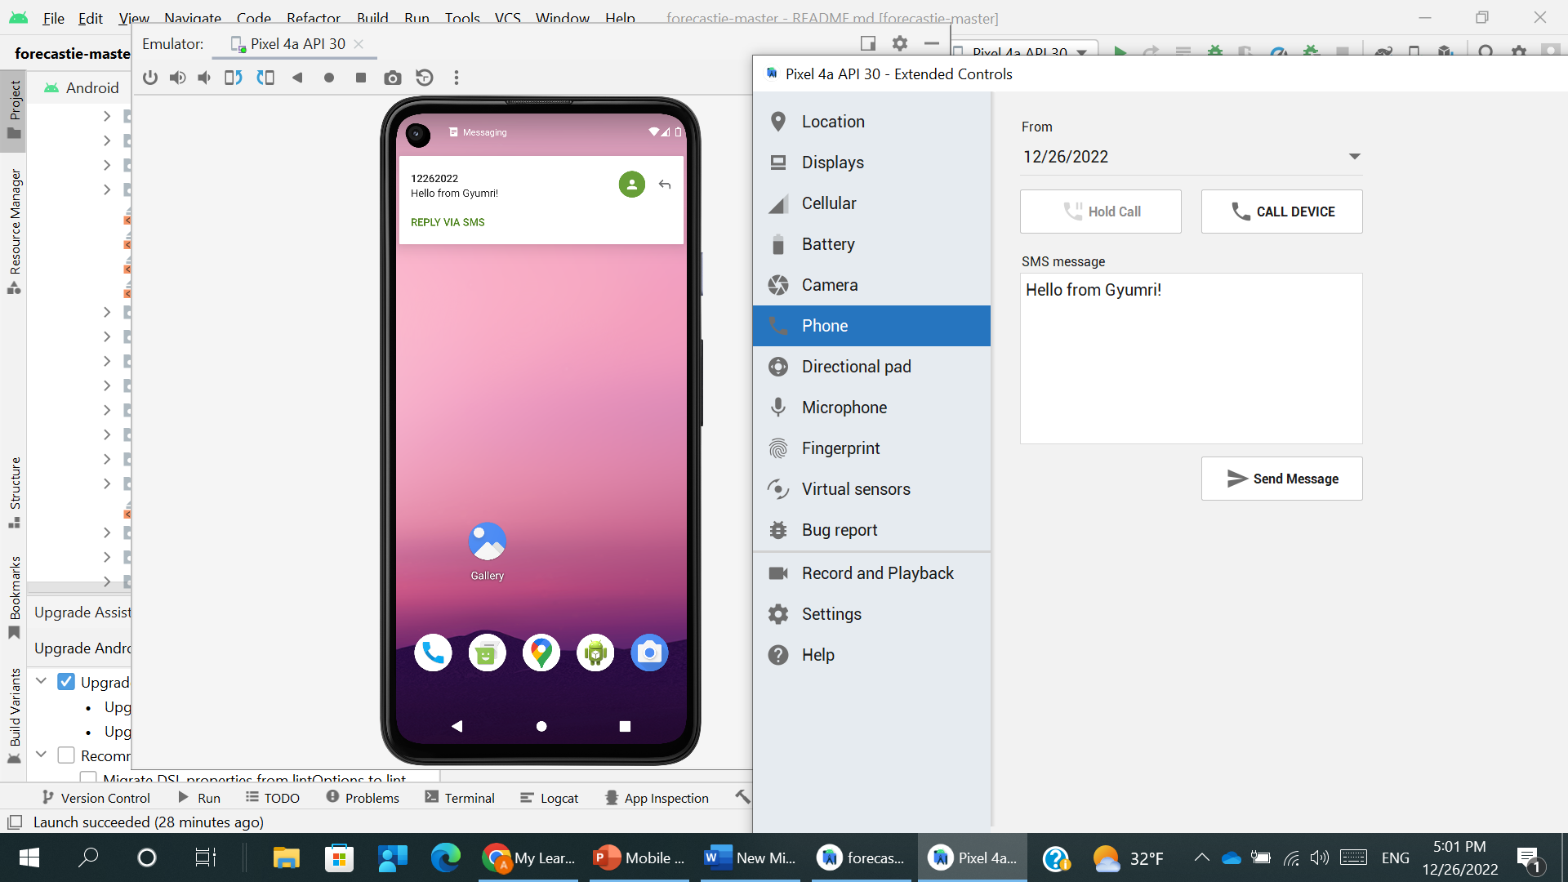

ANDROID #2.10
Working with Emulator: Emulate Incoming SMS
Number should be equal to current date

Slide 26
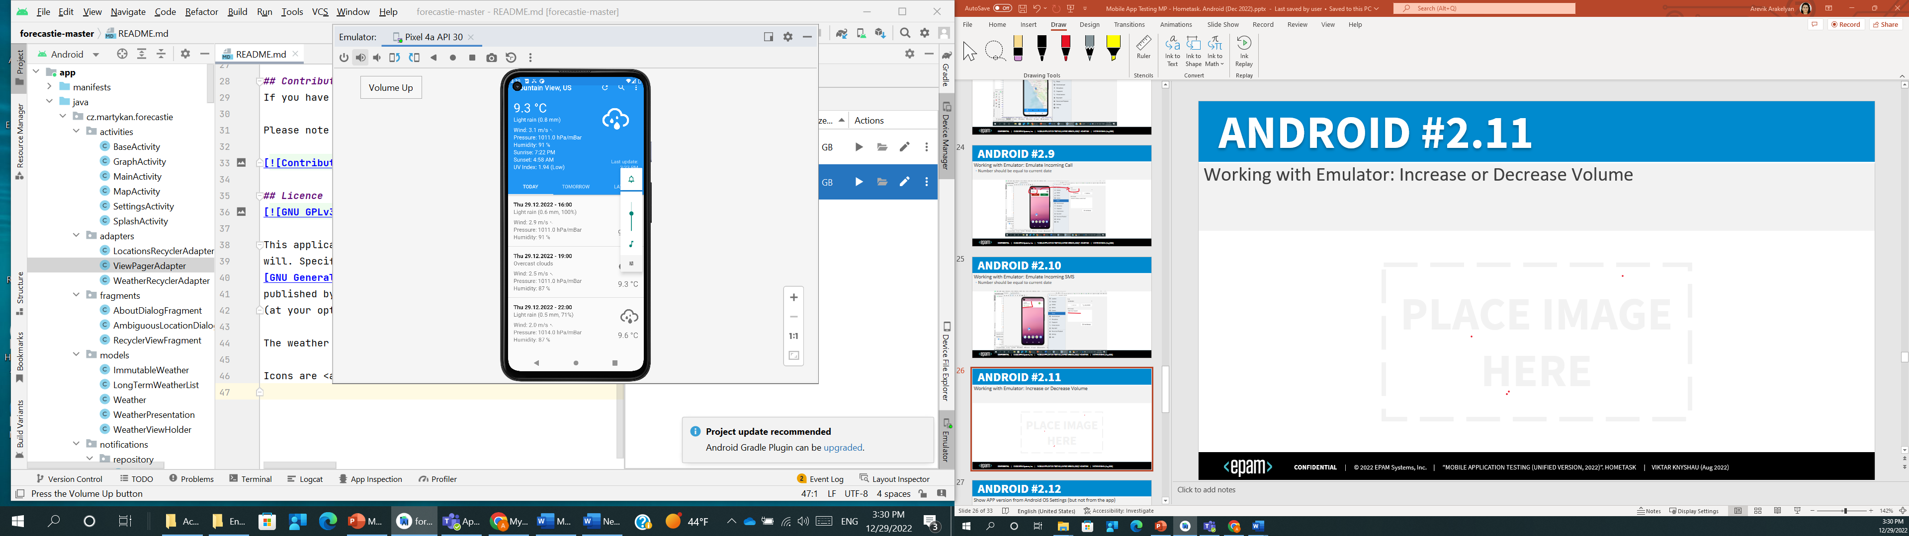

ANDROID #2.11
Working with Emulator: Increase or Decrease Volume

Slide 27
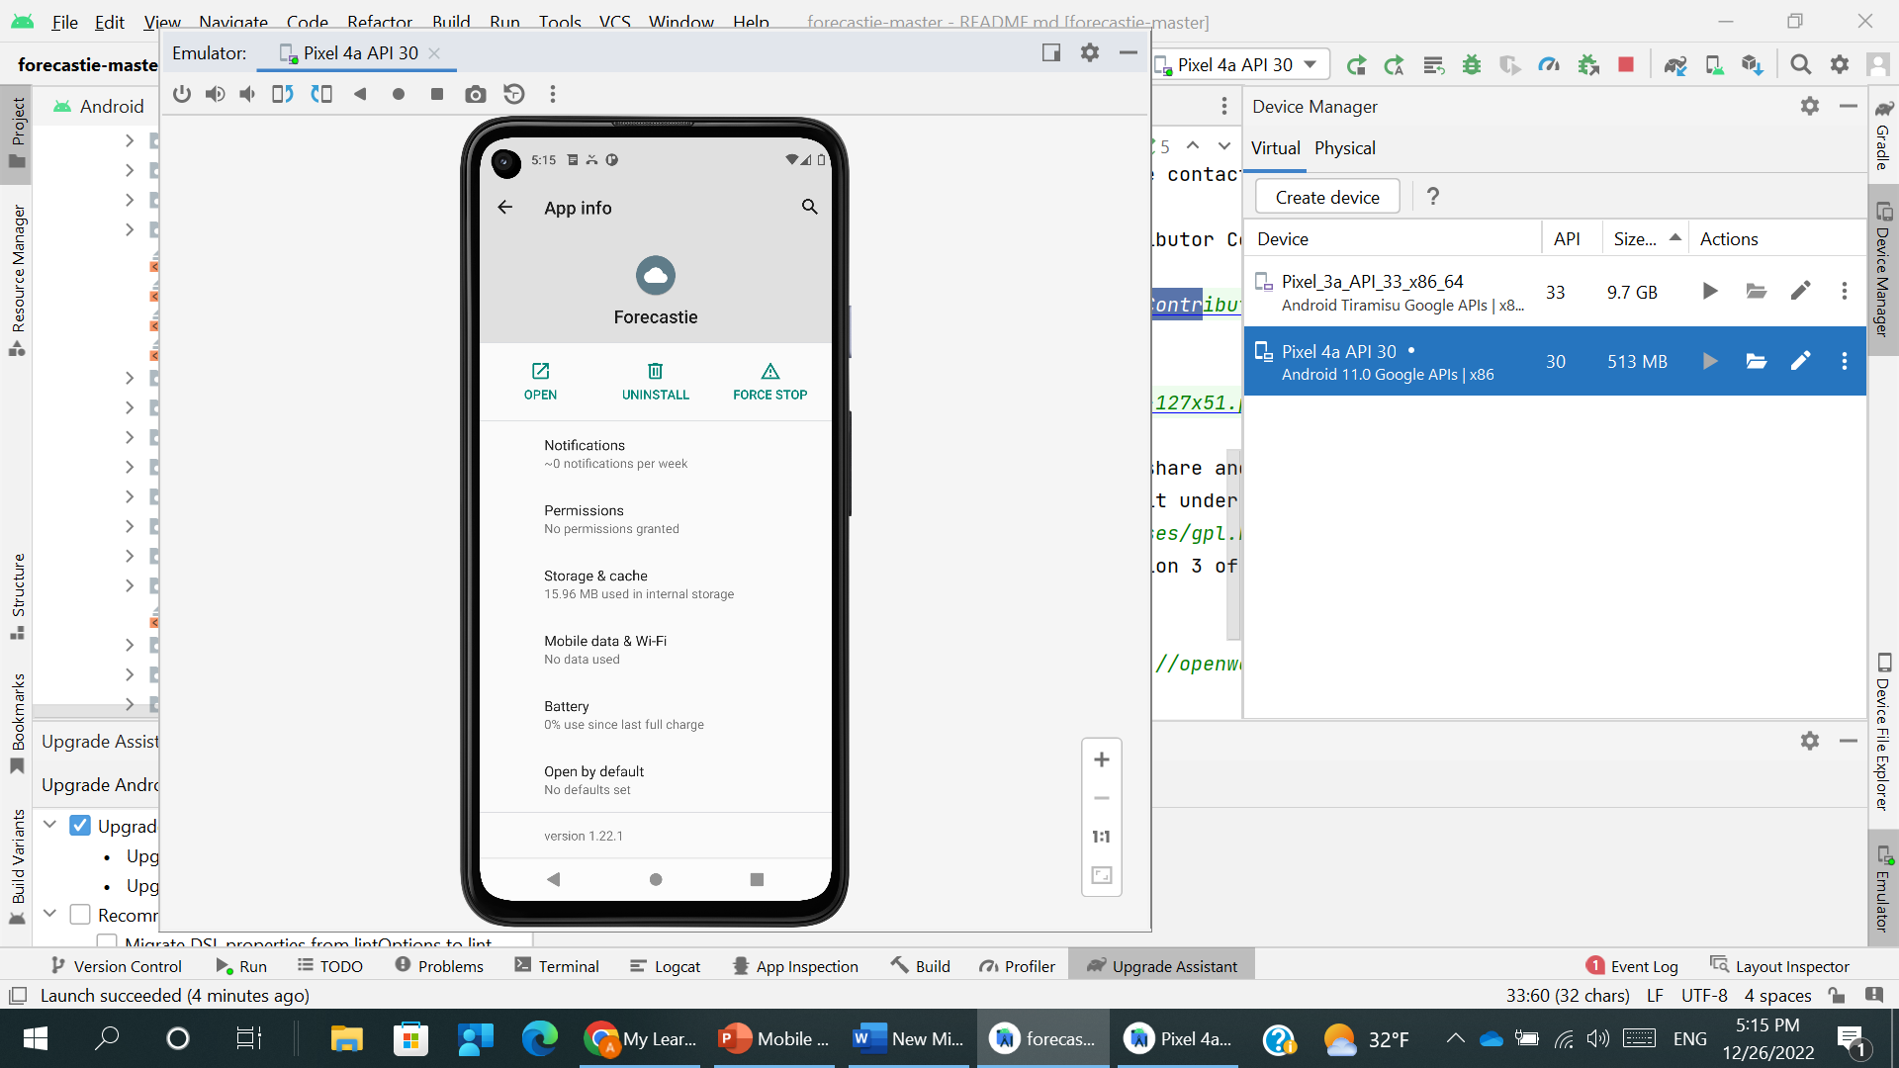
ANDROID #2.12
Show APP version from Android OS Settings (but not from the app)

Slide 28
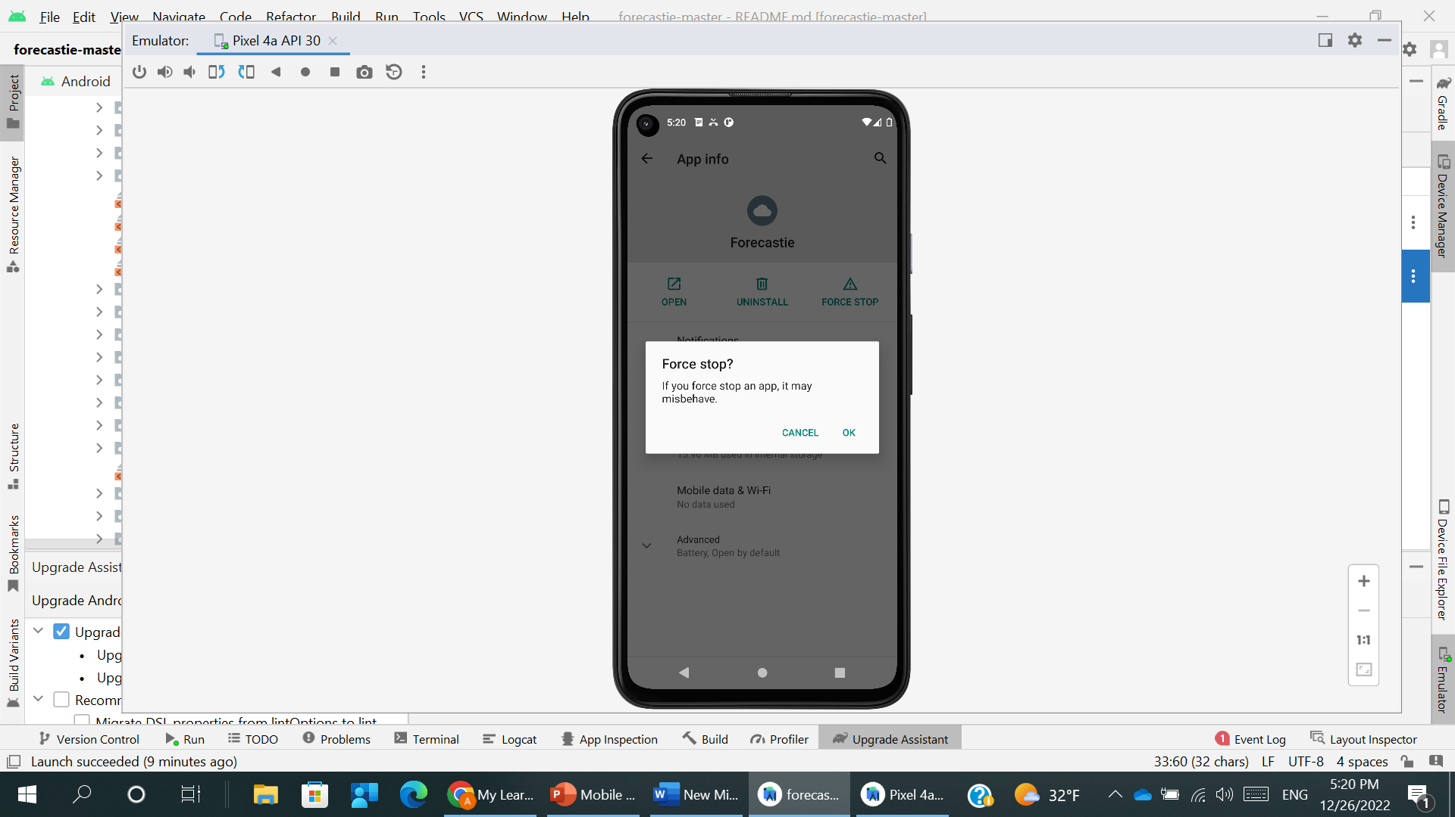
ANDROID #2.13
Place where to FORCE STOP the app

Slide 29
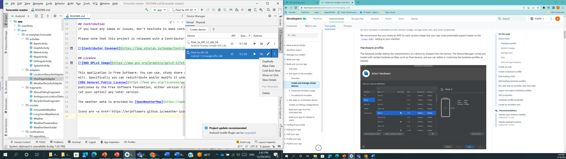

ANDROID #2.15
Place/ menu item where to wipe Android emulator
(remove => re-create isn’t acceptable)

Slide 30
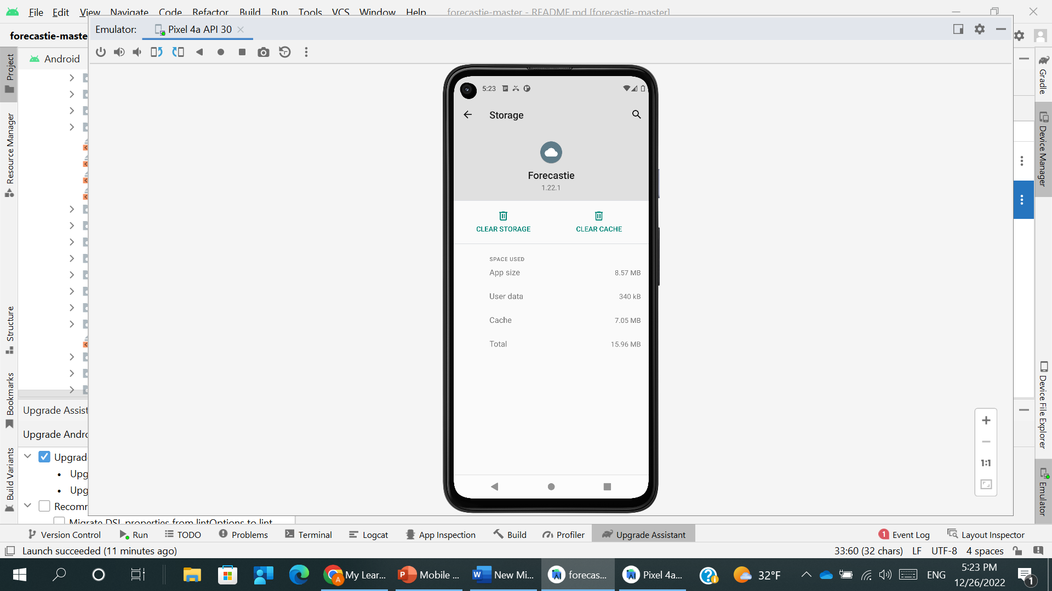

ANDROID #2.14
Place where to "CLEAR app DATA" and/or "CLEAR app CACHE"

Slide 31
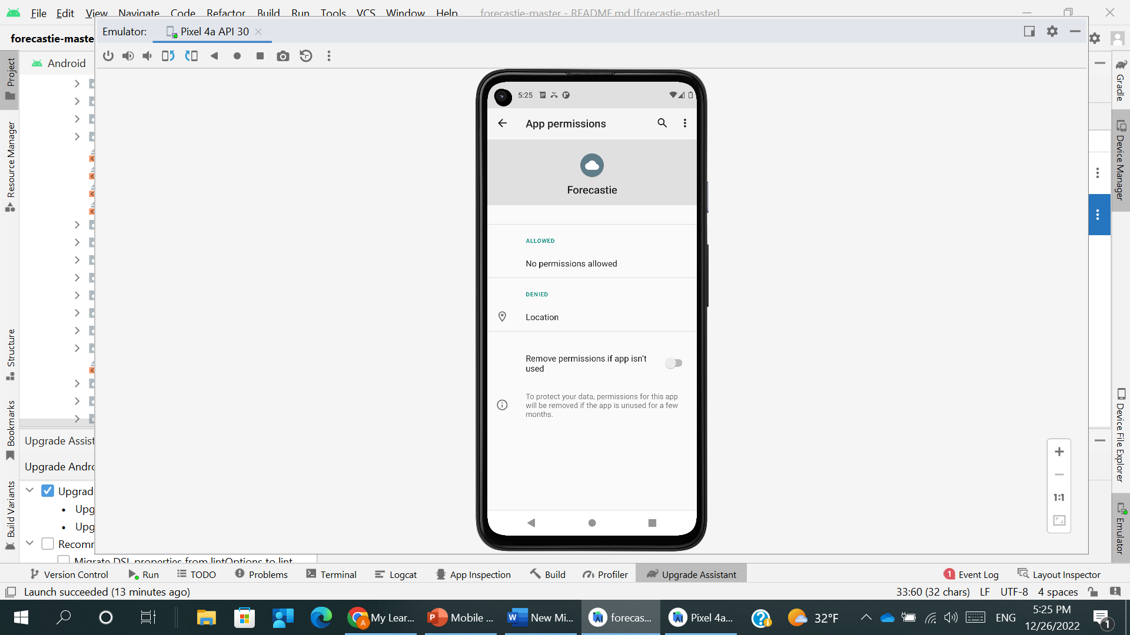
ANDROID #2 (optional)
Place where to allow using Geolocation for the specified app in the OS Settings

Slide 32
ANY COMMENTS?

Slide 33
FEEDBACK FORM
Feel free to share any notes for me in case of any ☺. Some ideas:
What was the most difficult?
How much time did you spend for tasks? …
Type text here please…
Thank you!
It was interesting job for me

